Slide 1
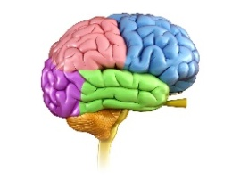
University of Basrah
Al-Zahraa Medical College
Ministry of higher Education and Scientific Research
Academic year 2021-2022
3rd year S6
Extrapyramidal system
Physiology of Basal Ganglia & Cerebellum
Session: 5 Lecture: 1
Module staff:
Dr. Mohammed yas Mohammed
Dr.Nehaya Mnahi Al-Aubody
Dr.Wisam Abdullah Jasim
Dr.Abulrazzaq jasim amir
Dr. Nada Hashim Al-Jassim
Dr. Raghda S.Al-Najjar
Dr. Ansam Munadhel Hussein
Dr. Ahmed Bader
For more discussion, questions or cases need help please post to the session group
Guyton and Hall Textbook of Medical Physiology, 12th Ed CHAPTER 57

Slide 2
University of Basrah
Al-Zahraa Medical College
Ministry of higher Education and Scientific Research
Learning outcomes
LO1 :Discuss the general role of the cerebellum and basal ganglia in voluntary movement .
LO2 :Describe the organization of the cerebellum
• List the major inputs/outputs to and from the cerebellum
• List the major functions of the three functional divisions of the cerebellum
LO3 :Describe the organization of the basal ganglia
• List the major inputs/outputs to and from the basal ganglia and their corresponding neurotransmitters.
LO4 :Trace the connections of both the direct and indirect pathway of the basal ganglia and their contributions to movement
LO5 :Relate how disorders of the basal ganglia such as Parkinson’s disease affect these pathways

Slide 3
University of Basrah
Al-Zahraa Medical College
Ministry of higher Education and Scientific Research
Role of the cerebellum and basal ganglia in voluntary movement .
LO1
The basal ganglia (BG) buried deep inside the cerebrum.
The cerebellum and the BG are major subcortical nuclei that control voluntary movement through their interactions with the cerebral cortex.
The role of the BG is initiating and regulating motor commands
The cerebellum is precisely regulate the sequence and duration of the elementary movements
Notes:
For you to perform even so simple a gesture as touching the tip of your nose, it is not enough for your brain to simply command your hand and arm muscles to contract. To make the various segments of your hand and arm deploy smoothly, you need an internal "clock" that can precisely regulate the sequence and duration of the elementary movements of each of these segments. That clock is the cerebellum.

Slide 4
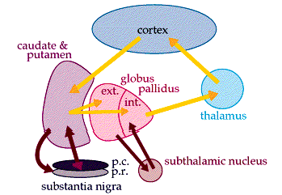
University of Basrah
Al-Zahraa Medical College
Ministry of higher Education and Scientific Research
Role of the cerebellum and basal ganglia in voluntary movement .
LO1
The basal ganglia receive information from several different regions of the cerebral cortex. Once the basal ganglia have processed this information, they return it to the motor cortex via the thalamus. To initiate movement

Slide 5
University of Basrah
Al-Zahraa Medical College
Ministry of higher Education and Scientific Research
The cerebellum first receives information about the intended movement from the sensory and motor cortexes.
Then it sends information back to the motor cortex about the required direction, force, and duration of this movement thus this loop involving the cerebellum operates in addition to the loop involving the basal ganglia to regulate the details of motor control.(to select and trigger well co-ordinated voluntary movements)
LO1
Notes:
For you to perform even so simple a gesture as touching the tip of your nose, it is not enough for your brain to simply command your hand and arm muscles to contract. To make the various segments of your hand and arm deploy smoothly, you need an internal "clock" that can precisely regulate the sequence and duration of the elementary movements of each of these segments. That clock is the cerebellum.

Slide 6
University of Basrah
Al-Zahraa Medical College
Ministry of higher Education and Scientific Research
LO1
The cerebellum and the basal ganglia are major subcortical nuclei that control multiple aspects of neurological behavior largely through their interactions with the cerebral cortex.
Discrete multi synaptic loops connect both the cerebellum and the basal ganglia with multiple areas of the cerebral cortex.

Slide 7
University of Basrah
Al-Zahraa Medical College
Ministry of higher Education and Scientific Research
Functional Subdivisions of Cerebellum
LO2
Vestibulo cerebellum
archicerebellum
Spinocerebellum
(paleocerebellum)
Cerebrocerebellum
Corticocerebellum
(neocerebellum)

Slide 8
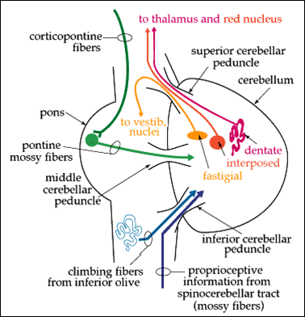
University of Basrah
Al-Zahraa Medical College
Ministry of higher Education and Scientific Research
The cerebellum input and projection
LO2
Afferent: (climbing and mossy fibers) synapse with Purkinje cells at middle layer of cerebellar cortex (3 layers)

Slide 9
University of Basrah
Al-Zahraa Medical College
Ministry of higher Education and Scientific Research
The cerebellum input and projection
LO2
Then from Purkinje cells the axons relay the impulses to 4 deep cerebellar nuclei receive input from cerebellar cortex and send projections to thalamus
Fastigial 2. 2 Interpose 3. Dentate
Information travels via cerebellar peduncles
Superior (efferent)
2. Middle (afferent)
3. Inferior (mixed)

Slide 10
University of Basrah
Al-Zahraa Medical College
Ministry of higher Education and Scientific Research
LO2
AFFERENT-EFFERENT CIRCUIT (CEREBRO- CEREBELLO-CEREBRAL CONNECTIONS)
Afferent-efferent circuit is an important neuronal pathway, involved in cerebellar control of voluntary movements, initiated by the motor area of cerebral cortex.
This pathway includes two tracts:
1. Cerebropontocerebellar tract
2. Dentatorubrothalamocortical tract.

Slide 11
University of Basrah
Al-Zahraa Medical College
Ministry of higher Education and Scientific Research
LO2
1. Cerebropontocerebellar tract
Fibers from motor areas 4 and 6 in frontal lobe of cerebral cortex enter the pontine nuclei. These fibers are called corticopontine fibers.
From pontine nuclei, the pontocerebellar fibers arise and pass through middle cerebellar peduncle of the opposite side and terminate in the cerebellar cortex.

Slide 12
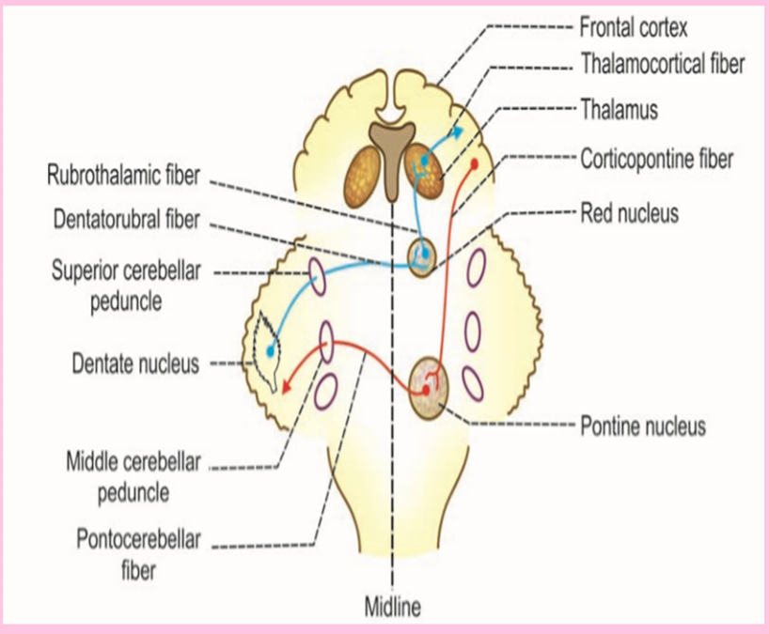
University of Basrah
Al-Zahraa Medical College
Ministry of higher Education and Scientific Research
2. Dentatorubrothalamocortical tract.
LO2
Cerebellar cortex is, in turn, connected to the dentate nucleus. Fibers from the dentate nucleus pass via superior cerebellar peduncle and end in red nucleus of opposite side. These fibers are called dentatorubral fibers
From red nucleus, the rubrothalamic fibers go to thalamus. Thalamus is connected to areas 4 and 6 in motor cortex of cerebrum by thalamocortical fibers.

Slide 13
University of Basrah
Al-Zahraa Medical College
Ministry of higher Education and Scientific Research
LO2
Schematic representation of cerebro-cerebello-cerebral circuit

Slide 14
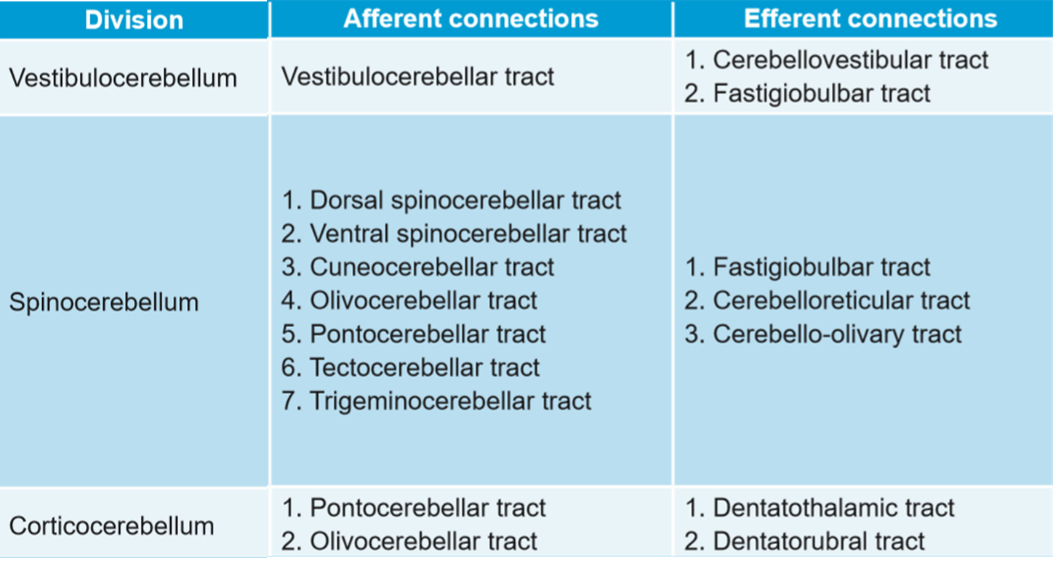
University of Basrah
Al-Zahraa Medical College
Ministry of higher Education and Scientific Research
connections of functional division of cerebellum (input &output )
LO2

Slide 15
University of Basrah
Al-Zahraa Medical College
Ministry of higher Education and Scientific Research
Functions of functional division of cerebellum
LO2
Division | FUNCTION Of divisions | FUNCTION of cerebellum
Vestibulocerebellum | - Regulate movements underlying posture and equilibrium -Coordination of eye and head movements | 1. Regulation of tone, posture and equilibrium
Spinocerebellum | Motor coordination Lateral portion Movement of distal muscle (ex. gross movements during walking) Central portion (vermis) Movement of proximal muscles
Corticocerebellum | - Planning and timing of sequential movements - Speech | 2. Regulation of coordinated movements

Slide 16
University of Basrah
Al-Zahraa Medical College
Ministry of higher Education and Scientific Research
LO2
In addition to motor control the cerebellum may also be involved in some cognitive functions such as attention and language as well as in regulating fear and pleasure responses
Connection of the cerebellum with cerebral cortex should pass through the thalamus
?
Lesions to any division of cerebellum result in impairments on ipsilateral side of the body
Notes:
The cerebellum has also been conceptualized as anterior, middle, and ﬂocculonodular lobes. These subdivisions cannot be directly equated to the subdivisions described above

Slide 17
University of Basrah
Al-Zahraa Medical College
Ministry of higher Education and Scientific Research
LO2
What are the double crossing in pathway from cerebellum to its target tissues

Slide 18
University of Basrah
Al-Zahraa Medical College
Ministry of higher Education and Scientific Research
LO2
APPLIED PHYSIOLOGY – CEREBELLAR LESIONS
DISTURBANCES IN TONE & POSTURE
DISTURBANCES IN EQUILIBRIUM
While Standing & While Moving – Gait
DISTURBANCES IN MOVEMENTS
Eg. Ataxia& Nystagmus
Notes:
Ataxia describes a lack of muscle control or coordination of voluntary movements, such as walking or picking up objects. A sign of an underlying condition, ataxia can affect various movements and create difficulties with speech, eye movement and swallowing.

Slide 19
University of Basrah
Al-Zahraa Medical College
Ministry of higher Education and Scientific Research
The cerebellum
LO2
The cerebellum is especially vital to the control of very rapid muscular activities such as running, typing, playing the piano, and talking.
Loss of this area of the brain can cause almost total incoordination of these activities even though its loss causes no paralysis of any muscle.
Lesions to any division of cerebellum result in impairments on unilateral and ipsilateral side of the body
general, during cerebellar lesions, there are disturbances in posture, equilibrium and movements.
Most of the disturbances are due to the damage to corticocerebellum (neocerebellum) because in human beings, it is larger than other divisions.

Slide 20
University of Basrah
Al-Zahraa Medical College
Ministry of higher Education and Scientific Research
LO3
The basal ganglia
(more appropriately, the basal nuclei)
Are essential subcortical nuclei of grey matter of the forebrain, lying deep to the white matter of the cerebral cortex.
They play a prominent role in initiating and modulating movement, as well as cognitive and emotional functions, through a complex series of feedback loops to and from the cerebral cortex.

Slide 21
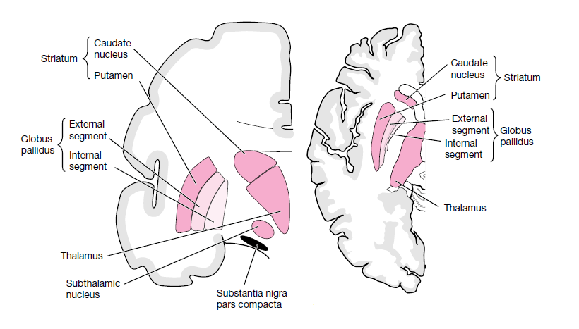
University of Basrah
Al-Zahraa Medical College
Ministry of higher Education and Scientific Research
LO3
The basal ganglia circuits include two core structures:
Putamen
The caudate
Globus pallidus.
Two other critical components of the basal ganglia are:
the substantia nigra
the subthalamic nucleus
The striatum
lenticular nucleus

Slide 22
University of Basrah
Al-Zahraa Medical College
Ministry of higher Education and Scientific Research
THE FUNCTIONS OF BASAL GANGLIA
LO3
(motor control)
Caudate nucleus with cerebral cortex
•Planning sequence of cognitive complex movements
Control timing (rapid or slow)
Scale (small or large)
Putamen circuit with corticospinal tract
•Execute subconscious learned pattern of movement
Globus pallidus: posture taken to perform particular movement
Initiation and regulation of gross intentional movements
•e.g: Facial expression & swinging arm with walking
5) Basal ganglia mainly inhibitory to muscle tone

Slide 23
University of Basrah
Al-Zahraa Medical College
Ministry of higher Education and Scientific Research
Connection of basal ganglia
LO3
1- basal ganglia has two circuits: caudate circuit and putamen circuit
The signals to the BG are come either from
associated areas in cerebral cortex → caudate nucleus
or premotor and supplementary motor (SMA) areas in cerebral cortex → putamen
Then from caudate nucleus or from putamen send signals to the Globus Pallidus
To reach the cerebral cortex should pass through the thalamus ( the only somatic nuclei in the thalamus are ventroanterio nucleus and ventrolateral nucleus )
Caudate circuit end in Premotor & SMA in cerebral cortex from which the putamen circuit is started
2- basal ganglia have efferent signals from Globus Pallidus to :
Vestibular nucleus
Subthalamic nucleus
Substantia nigra
Red nucleus
Reticular formation

Slide 24
University of Basrah
Al-Zahraa Medical College
Ministry of higher Education and Scientific Research
LO4
Neurotransmitters of basal ganglia pathways
Ach
Stimulate motor cortex
Glutamate
Stimulator
GABA
Inhibitor
dopamine
Inhibitor

Slide 25
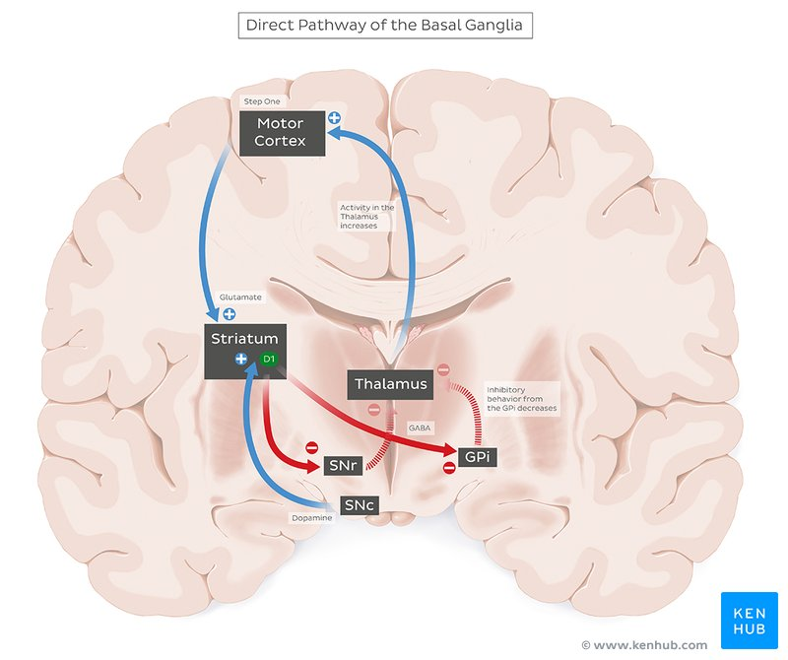
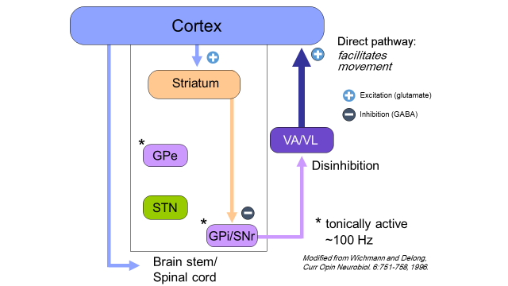
University of Basrah
Al-Zahraa Medical College
Ministry of higher Education and Scientific Research
Direct and indirect pathway of the basal ganglia
LO4

Slide 26
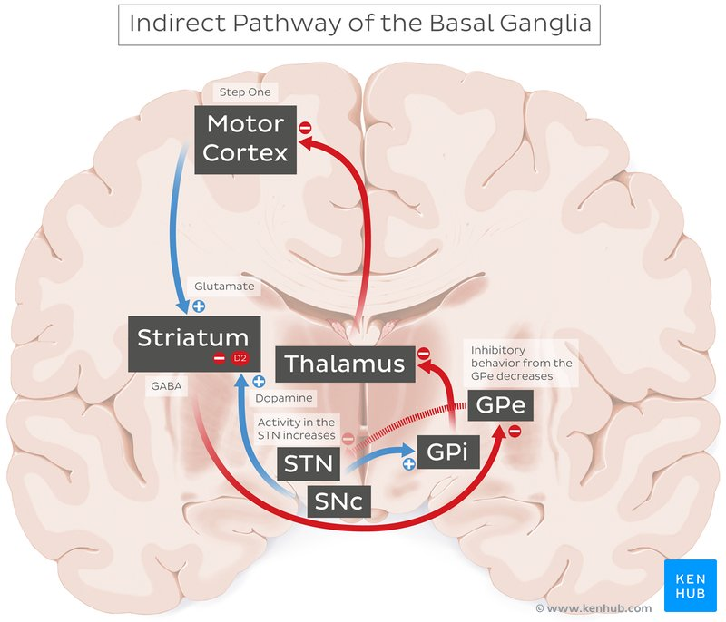
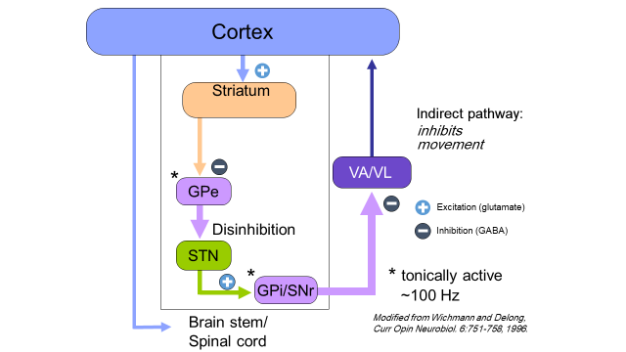
University of Basrah
Al-Zahraa Medical College
Ministry of higher Education and Scientific Research
Direct and indirect pathway of the basal ganglia
LO4

Slide 27
University of Basrah
Al-Zahraa Medical College
Ministry of higher Education and Scientific Research
LO4
Direct pathway: Disinhibits motor thalamus, and thus activates thalamo-cortical neurons. Consequently, activates motor cortex and facilitates movement.
Indirect pathway: Inhibits motor thalamus, and thus inhibits thalamo-cortical neurons. Consequently, inhibits motor cortex and inhibits movement
The two striatal output pathways are affected differently by the dopaminergic projection from the substantia nigra pars compacta (SNc) because they have different dopamine receptors (D1 and D2).
The internal pallidal segment (and substantia nigra pars reticulata) constitute the output nucleus of the basal ganglia and provide tonic GABAergic inhibition of the thalamic nuclei that project to different portions of the frontal lobe, including the prefrontal cortex and supplemental motor area, and to brainstem targets that control locomotion or eye movements.

Slide 28
University of Basrah
Al-Zahraa Medical College
Ministry of higher Education and Scientific Research
Basal ganglia summary
LO4
The main input to the basal ganglia is from the ipsilateral frontal cortex; the basal ganglia project back to the frontal cortex through a relay in the thalamus.
function of : initiation, sequencing and modulation (smoothness and precision) of motor activity
Basal nuclei help plan, organize, and coordinate motor movements and posture.
The internal pallidal segment (and substantia nigra pars reticulata) constitute the output nucleus of the basal ganglia and provide tonic GABAergic inhibition of the thalamic nuclei that project to different portions of the frontal lobe, including the prefrontal cortex and supplemental motor area, and to brainstem targets that control locomotion or eye movements.

Slide 29
University of Basrah
Al-Zahraa Medical College
Ministry of higher Education and Scientific Research
LO5
Over activity in the indirect pathway
is a major factor in Parkinsonian signs
underactivity in the indirect pathway
is a major factor in hyperkinetic disorders such as hemiballism and chorea
Notes:
hemiballism (violent involuntary throwing movements of the limb after a lesion in the contralateral subthalamic nucleus), Huntington disease (which is an autosomal dominant hyperkinetic disorder characterized by chorea, dementia and behavioral disturbance).

Slide 30
University of Basrah
Al-Zahraa Medical College
Ministry of higher Education and Scientific Research
LO5
Motor behavior is determined by the balance between direct/indirect striatal outputs
insufficient direct pathway output
excess indirect pathway output
insufficient indirect pathway output
excess direct pathway output
Hypokinetic disorders
Hyperkinetic disorders

Slide 31
University of Basrah
Al-Zahraa Medical College
Ministry of higher Education and Scientific Research
Thank you

